Slide 1
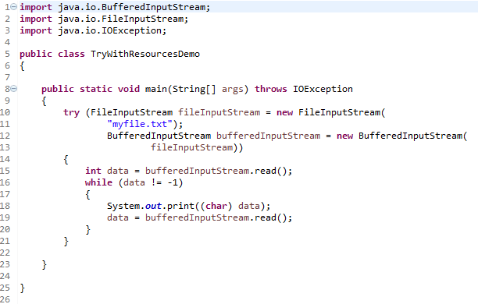
Try-with-resources[Using Multiple Resources]
We can use multiple resources inside a try-with-resources block and have them all automatically closed.
This example creates two resources inside the parentheses after the try keyword. An FileInputStream and a BufferedInputStream. Both of these resources will be closed automatically when execution leaves the try block.
The resources will be closed in reverse order of the order in which they are created / listed inside the parentheses. First the BufferedInputStream will be closed, then the FileInputStream.

